Slide 1

School of E&EE
FACULTY OF ENGINEERING
Data Communications and Network Security
ELEC5471M
Section 4. Link layer and MAC.

Slide 2
Data Communications and Network Security
Learning Objectives To provide students with a knowledge and understanding of data communications and wireless sensor networks and how they are, and could be, used in a range of applications. (See module catalogue).
I will cover these objectives by:
Introductory lecture and the ISO/OSI 7-layer protocol architecture.
The Internet and the TCP/IP architecture.
You will examine the transport layer and in particular TCP and UDP.
Examining the way in which security can be provided across networks will be considered.
We’ll consider the functions of the network layer and IP.
We will develop methods of sharing a common transmission medium (MAC).

Slide 3
Data Communications and Network Security
What must you contribute?
Lectures will be the basic provision of material but YOUR private study is also required.
Also you need to do the web examples suggested, you need to read from all the advised texts and consult the other suggested texts.
You must spend time before each lecture preparing yourself for what the lecture will be about and after each lecture going over the content and checking your understanding.
The Assessment of the module:
Will check you have all met the learning objectives.
Will grade to what extent you have exceeded the objectives.
The exam questions I set will be on:
The layered protocol architectures (ISO and TCP/IP).
The transport layer and sessions across a network, TCP & UDP operation (including congestion control).
Network layer issues (including addressing and routing).
Link layer issues (e.g. MAC).
There will also be a project on the security aspects.

Slide 4
Data Communications and Network Security ELEC5471M
To be given by:
Prof A. H. Kemp
Possibly with support from experts studying in the field.
Assessment will be by 1 exam of 3 hours duration.
Advised texts:
Computer Networking by Kurose and Ross ISBN:0201976994
Protocols and architectures for wireless sensor networks by Holger, K. and Willig, A. Hoboken, NJ : Wiley, 2007, c2005.
Computer Networks, by Tanenbaum ISBN:0133499456
Multimedia communications by Halsall ISBN:0201398184
Also for general reading:
Data & Computer Communications, by Stallings ISBN:0135712742

Slide 5
Link layer and MAC
MAC issues:
Fundamentals of MAC
Energy efficient
802.15.4 MAC
MAC sub-layer
Notes:
According to the ISO/OSI model architecture MAC is performed in the data link layer. In WSNs typically MAC is such a major issue that it is dealt with separately, between the PHY and DLL. We treat both in the same lecture due to time pressures but they are both big areas in the design and treatment of WSNs.

Slide 6
Link layer and MAC
MAC fundamentals:
Allow all users to access the ‘ether’.
Provide ‘fair’ division of resources.
Avoid ‘wasteful’ collisions.
In the context of WSNs minimize power consumption.
Particularly for wireless there can be different Tx and Rx interference footprints.
Localization can add other problems.
Notes:
By ether we mean shared channel or medium.
Medium Access Control determines the manner in which …

Slide 7
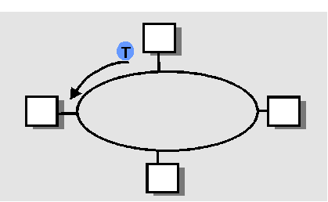
Link layer and MAC
Basic methods of MAC:
Fixed division (e.g. FDMA, TDMA).
Contention based.
Polling (e.g. Token ring).
Random access (e.g. ALOHA, CSMA)
Limited contention.
Binary countdown.
Basic bit-map.
Notes:
Revision…..
….. Maybe some kind of compromise is best…

Slide 8
Ideal Multiple Access Protocol
Broadcast channel of rate R bps
1. When one node wants to transmit, it can send at rate R.
2. When M nodes want to transmit, each can send at average rate R/M
3. Fully decentralized:
no special node to coordinate transmissions
no synchronization of clocks, slots
4. Simple

Slide 9
MAC Protocols: a taxonomy
Three broad classes:
Channel Partitioning (static allocation)
divide channel into smaller “pieces” (time slots, frequency, code)
allocate piece to node for exclusive use
Random Access (contention based)
channel not divided, allow collisions
“recover” from collisions
“Taking turns” (collision free)
tightly coordinate shared access to avoid collisions

Slide 10
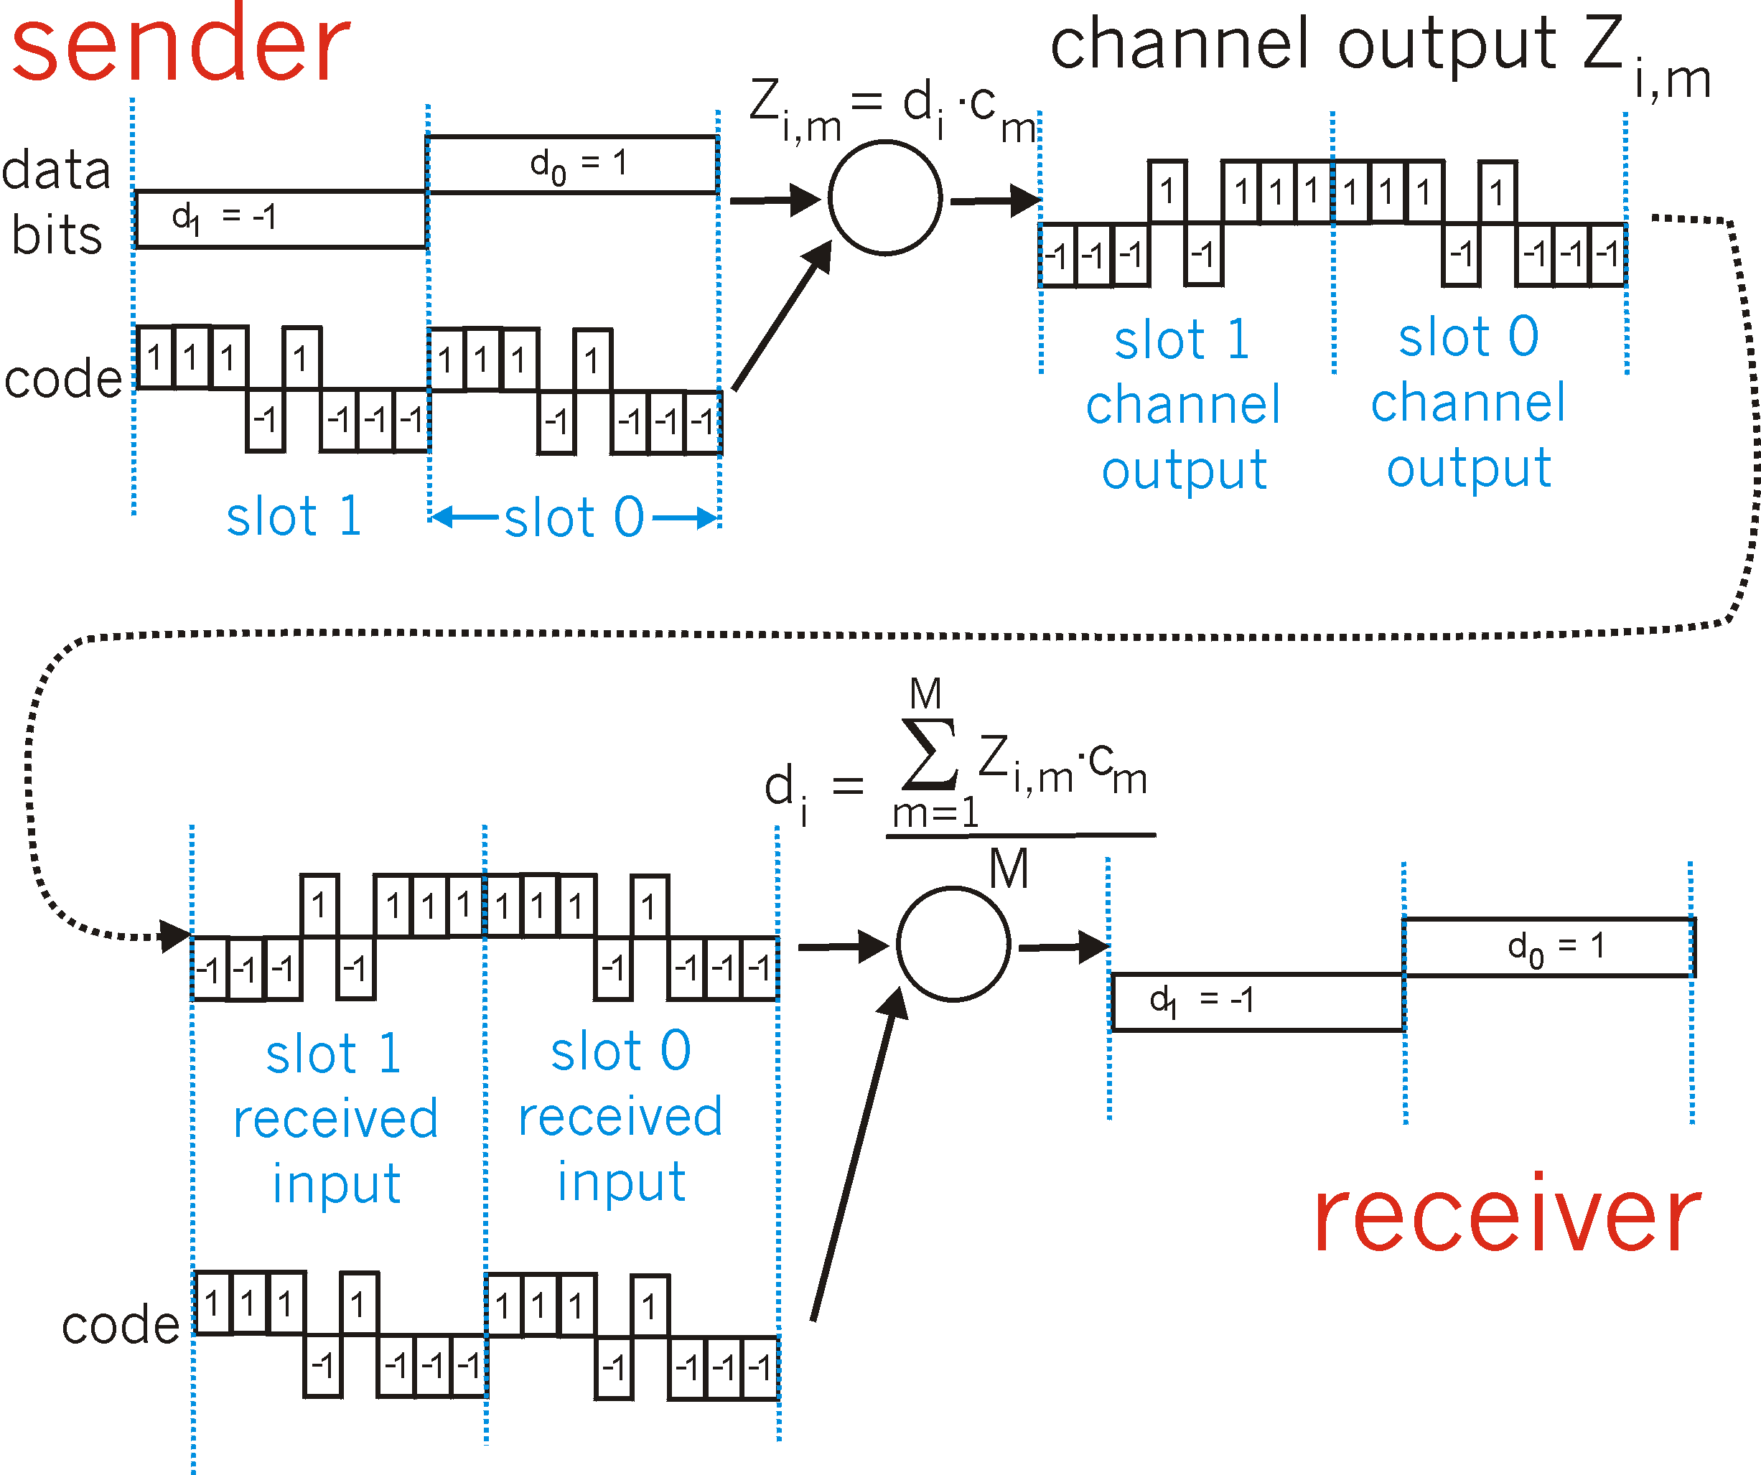
CDMA Encode/Decode

Slide 11
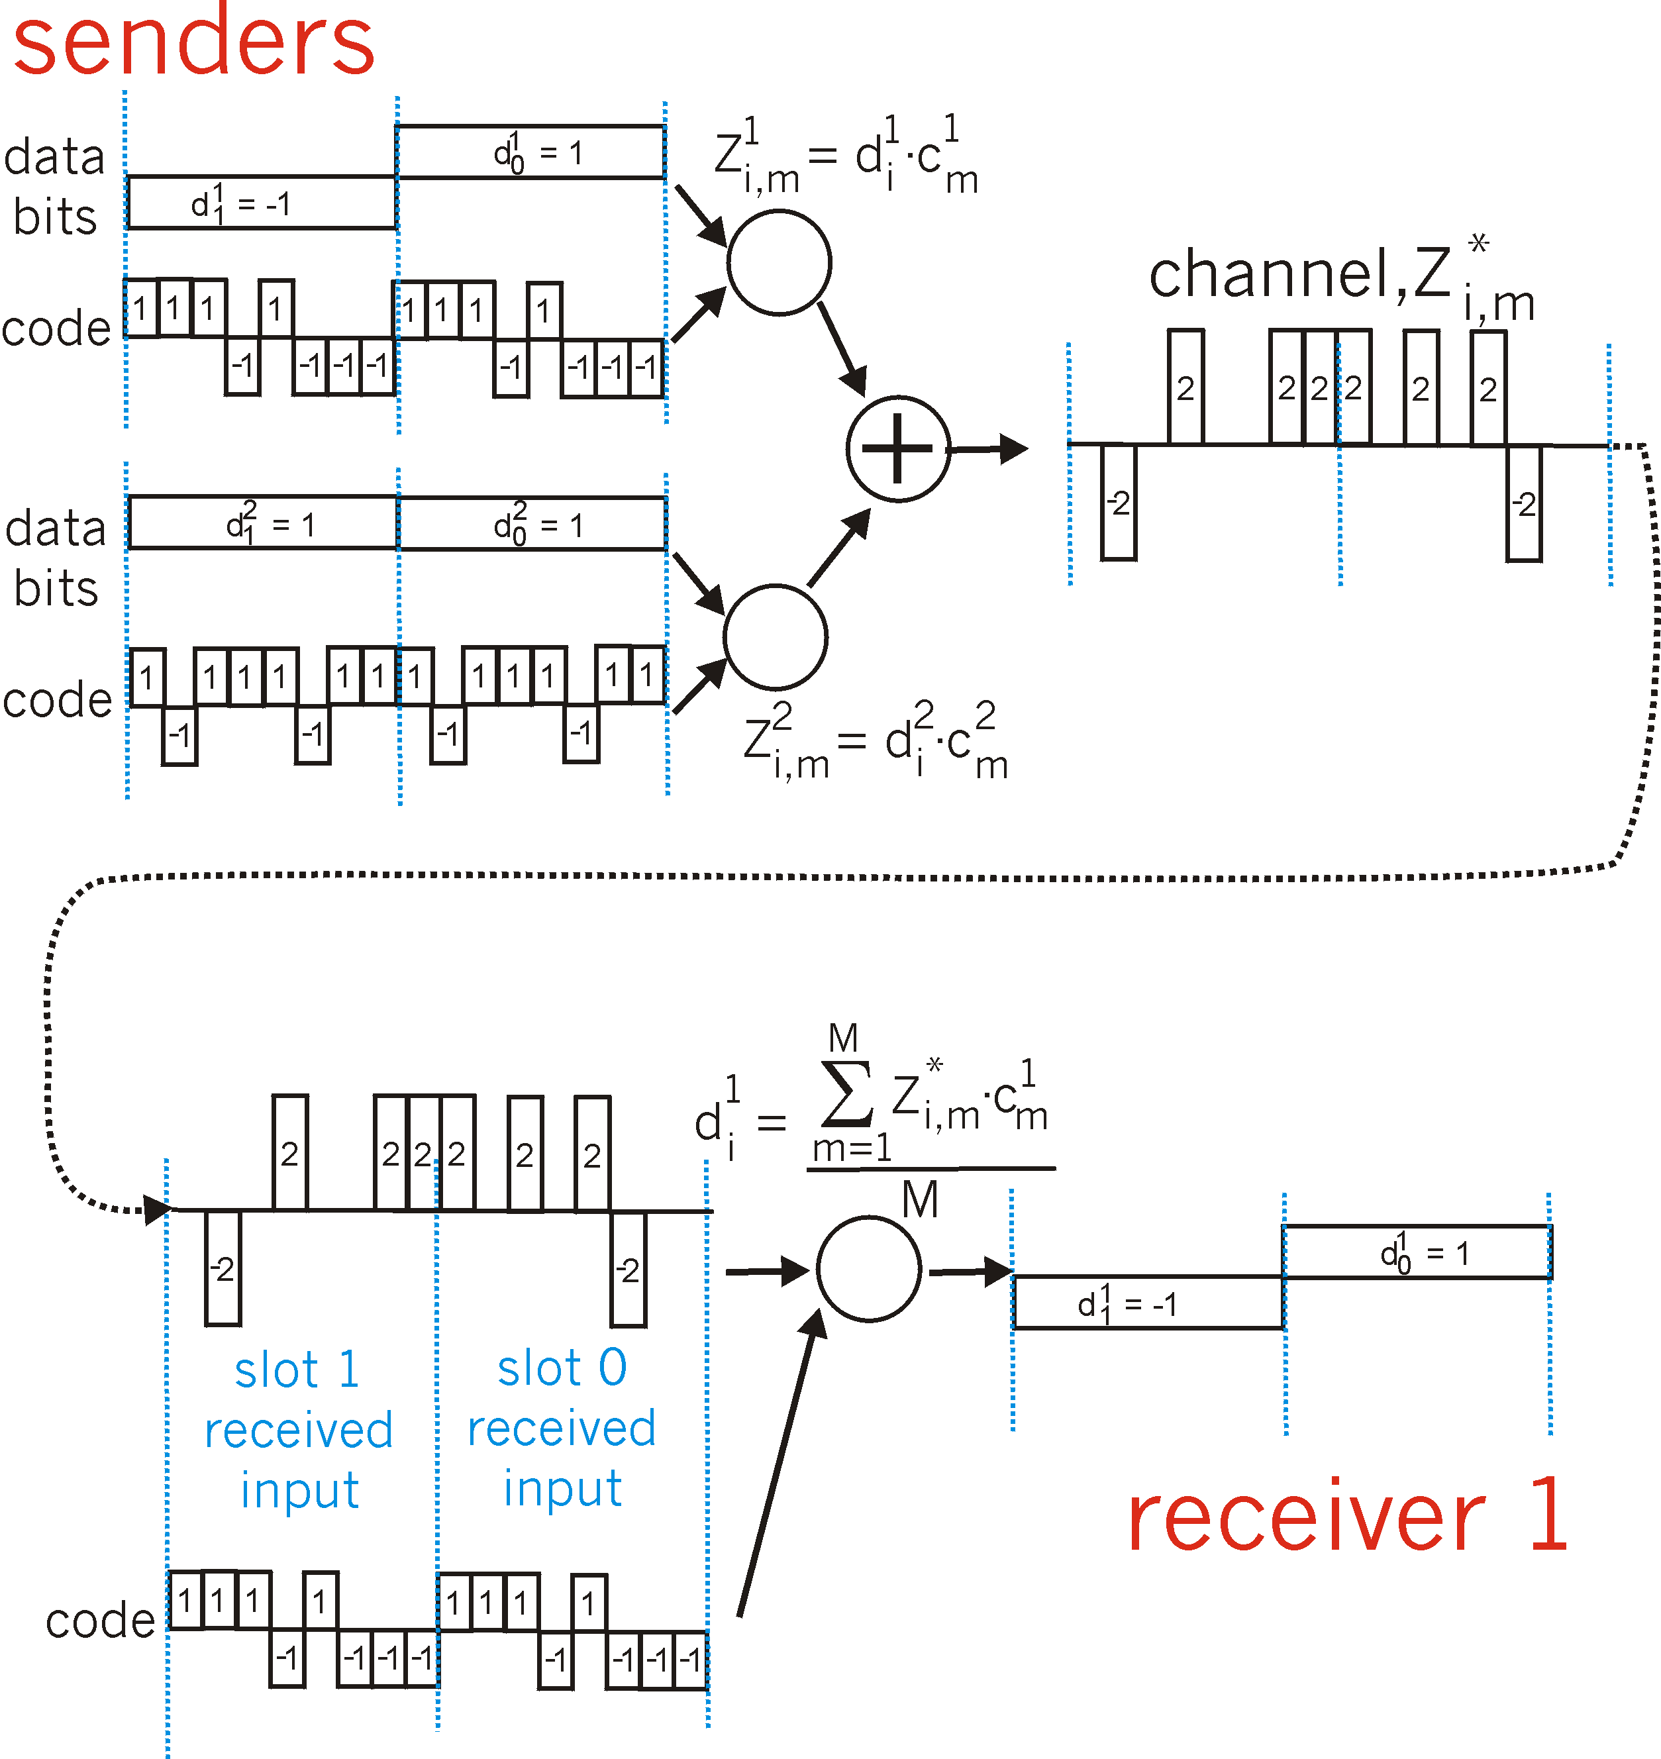
CDMA: two-sender interference

Slide 12
Channel Partitioning: Static Allocation.
Consider Frequency Division Multiplexing (FDM):
N users, each with equal portions of the spectrum.
(Tanenbaum: 4th Ed.:p248-251)

Slide 13
Channel Partitioning: Static Allocation.
Mean time delay, T for channel of capacity C bps and arrival rate of λ frames/s. Frame length is drawn from exponential pdf with mean (1/μ) bits/frame.
T = 1 / (μC – λ)
If the channel is now divided into N independent sub-channels with capacity C/N bps, the mean input rate to the sub-channels will be λ /N. Hence,
T_{FDM} = N / (μC – λ) = NT
Hence the mean delay using FDM is N times worse than all the frames being arranged in some big central queue.

Slide 14
Random Access Protocols
When node has packet to send
transmit at full channel data rate R.
no a priori coordination among nodes
two or more transmitting nodes -> “collision”,
random access MAC protocol specifies:
how to detect collisions
how to recover from collisions (e.g., via delayed retransmissions)
Examples of random access MAC protocols:
ALOHA
slotted ALOHA
CSMA, CSMA/CD, CSMA/CA

Slide 15
Random Access Protocols
ALOHA. (These are CONTENTION systems.) Tanenbaum 4th Ed.p251-4
Users transmit a frame whenever they have data to be sent i.e. at completely arbitrary times. Users sense if a collision has occurred. If it has, they wait a random amount of time and send it again.

Slide 16
Slotted ALOHA
Assumptions
all frames same size
time is divided into equal size slots, time to transmit 1 frame
nodes start to transmit frames only at beginning of slots
nodes are synchronized
if 2 or more nodes transmit in slot, all nodes detect collision
Operation
when node obtains fresh frame, it transmits in next slot
no collision, node can send new frame in next slot
if collision, node retransmits frame in each subsequent slot with prob. p until success

Slide 17
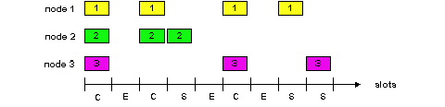
Slotted ALOHA
Pros
single active node can continuously transmit at full rate of channel
highly decentralized: only slots in nodes need to be in sync
simple
Cons
collisions, wasting slots
idle slots
nodes may be able to detect collision in less than time to transmit packet

Slide 18
What is the efficiency of Slotted-ALOHA?
Assume: infinite number of users, new frames generated according to a Poisson distribution with mean N frames per frame duration.
With the addition of re-transmissions the total is k and is also Poisson distributed with mean G. ( G > N )
Throughput is S = GP_{O} (where P_{O} is the probability that a frame does not suffer a collision).
A collision will not occur if no other frame is sent within the frame duration of the start of a frame. The probability that k frames are generated during a single ‘frame duration’ is given by the Poisson dist.:
Pr[k] = (G^{k} .e^{–G}) / k!
So prob. of zero frames is e^{–G}
From this we get throughput:
S = G e^{–G}

Slide 19
What is the efficiency of Slotted-ALOHA? -Offered traffic Vs throughput.

Slide 20
CSMA (Carrier Sense Multiple Access)
CSMA: listen before transmit:
If channel sensed idle: transmit entire frame
If channel sensed busy, defer transmission
Human analogy: don’t interrupt others!

Slide 21
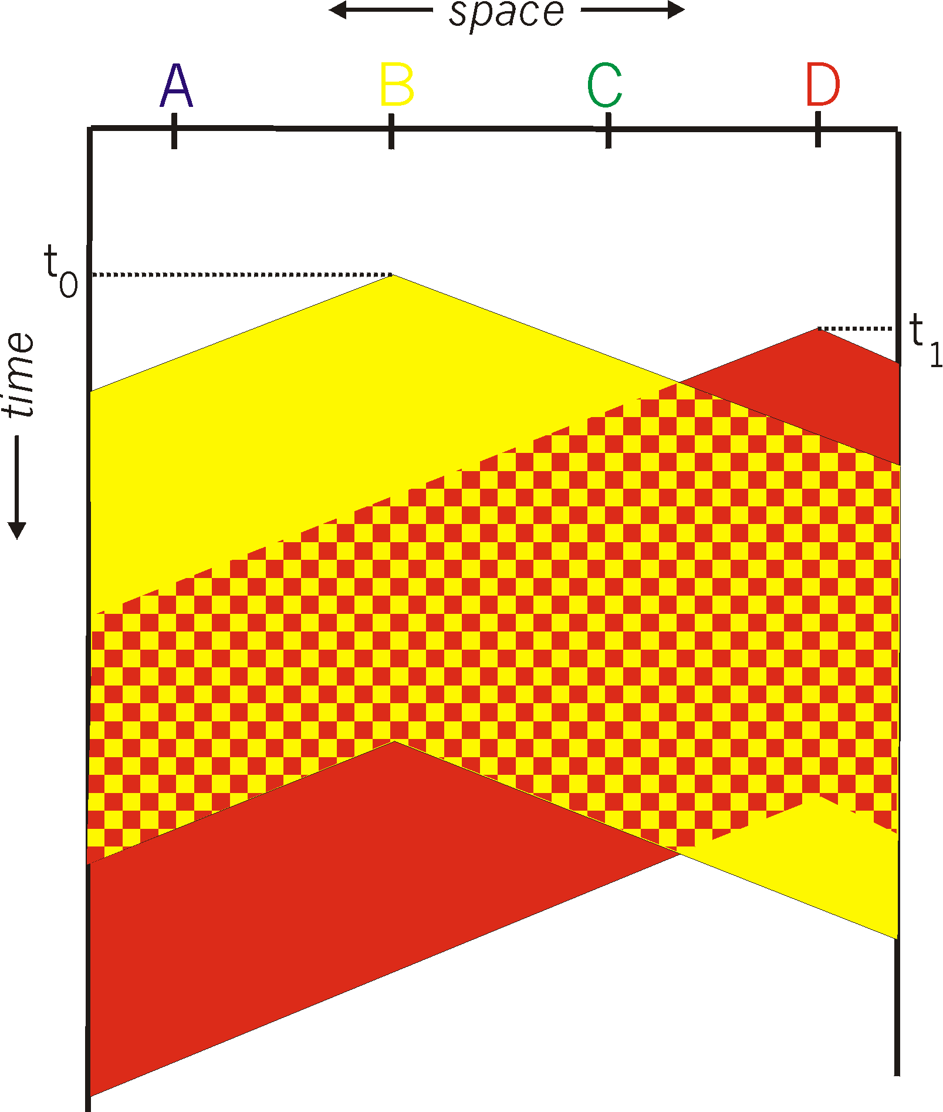
CSMA collisions
spatial layout of nodes
collisions can still occur:
propagation delay means
two nodes may not hear
each other’s transmission
collision:
entire packet transmission
time wasted
note:
role of distance & propagation delay in determining collision probability

Slide 22
CSMA/CD (Collision Detection)
CSMA/CD: carrier sensing, deferral as in CSMA
collisions detected within short time
colliding transmissions aborted, reducing channel wastage
collision detection:
easy in wired LANs: measure signal strengths, compare transmitted, received signals
difficult in wireless LANs: receiver shut off while transmitting
human analogy: the polite conversationalist

Slide 23
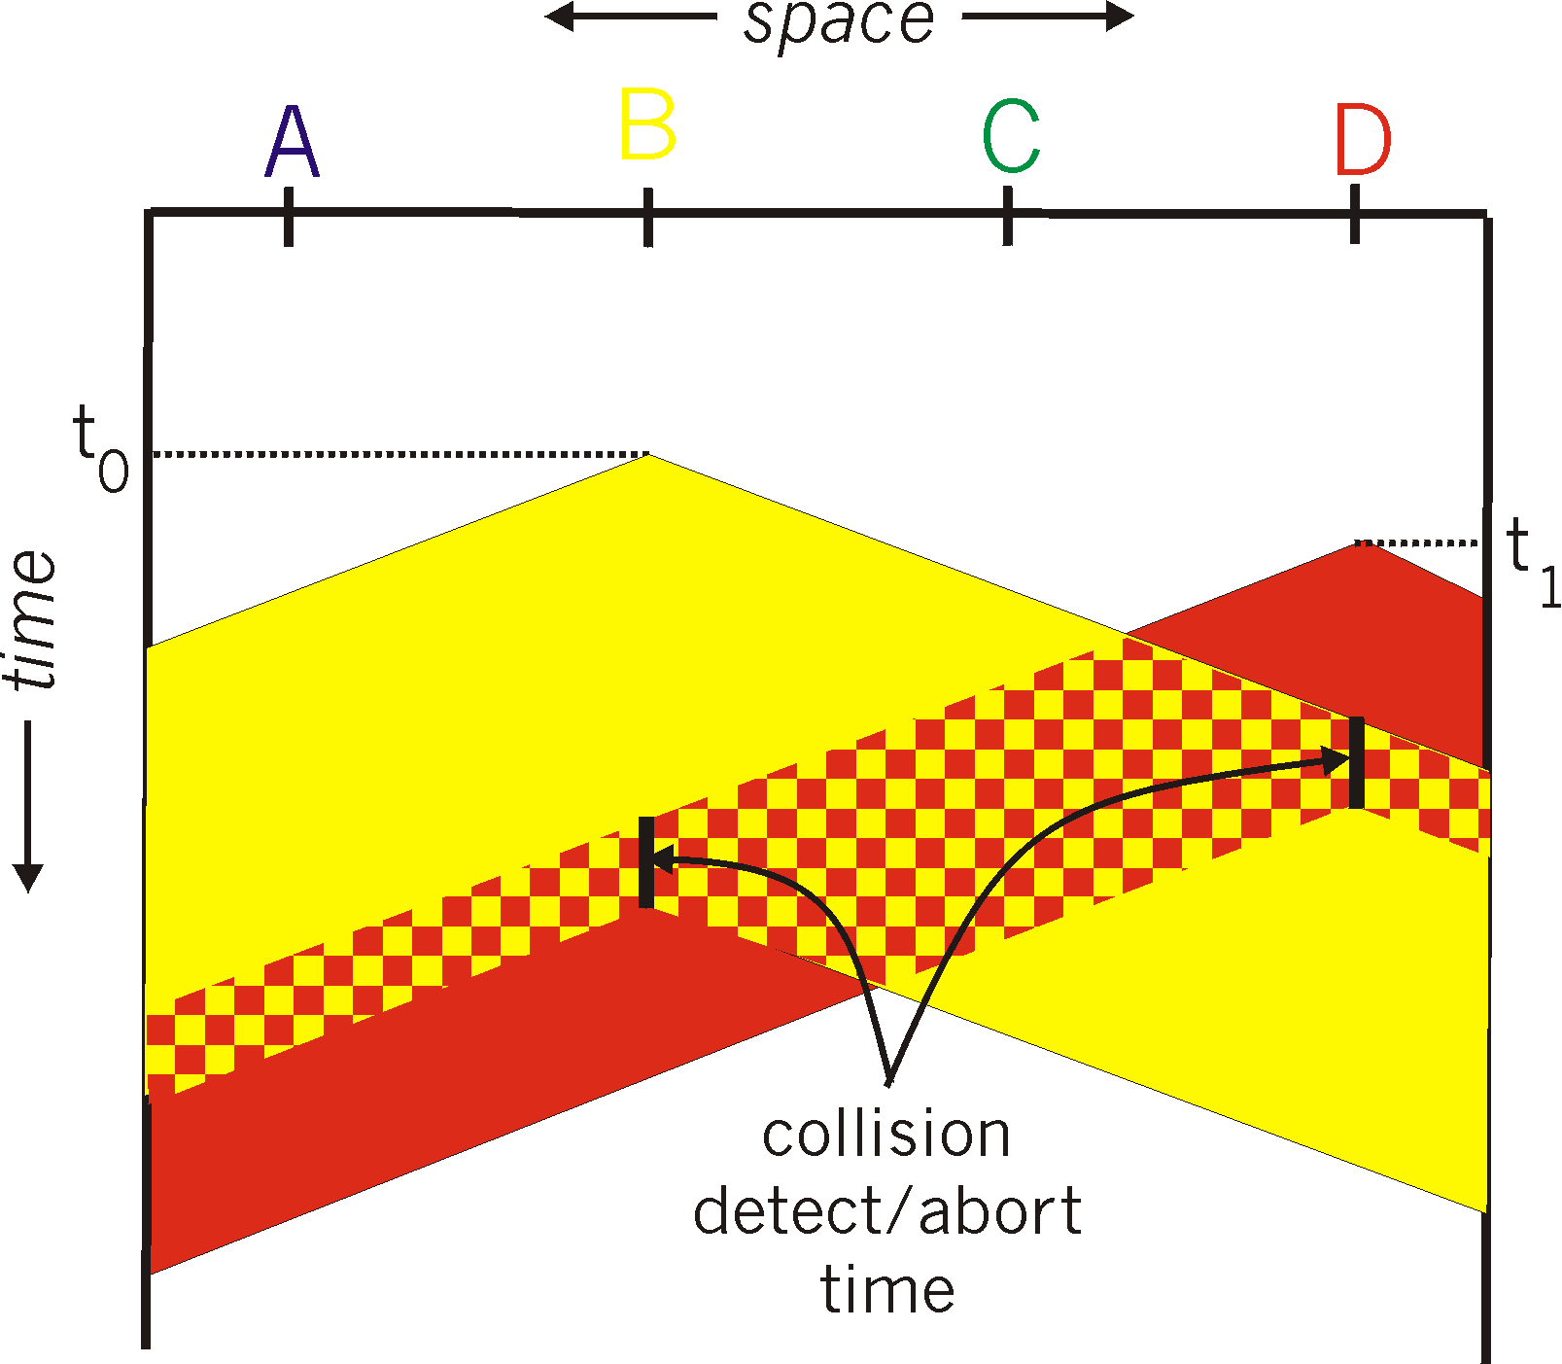
CSMA/CD collision detection

Slide 24
Carrier Sense Multiple Access (CSMA).
1-persistent CSMA:
When station has data to send it senses the channel.
If busy, waits until channel becomes idle.
When the channel is idle is transmits a frame.
If a collision occurs it waits a random amount of time and transmits again.
Called 1-persistent since if the channel is idle it transmits with probability 1.
Propagation delay has a big impact.
More than one station might be waiting for the channel to become idle (and so collide when it does).

Slide 25
Nonpersistent CSMA
As persistent CSMA except:
If a station finds the channel busy it doesn’t continuously sense it (with a view to transmitting as soon as it becomes idle). It waits a random time period then repeats. This improves channel utilisation but leads to longer delays.

Slide 26
P-persistent CSMA
This applies to slotted channels.
If station has data to send it senses the channel. If it is idle, it transmits with probability p. (Hence with probability q = 1 - p, it defers until the next slot).
At the next slot it again transmits or defers with probability p and q.
If the channel is detected as busy it waits a random time and starts again.

Slide 27
Channel utilisation Vs Load for various random access protocols.
G (attempts per packet time)

Slide 28
CSMA with Collision Detection (CSMA/CD).
Sensing the channel improves performance by reducing collisions.
Terminating transmission as soon as a collision is detected improves performance as it reduces time wasted on corrupted packets. After a collision is detected the station stops its transmission and waits a random time before reattempting to transmit.
Ethernet is CSMA/CD

Slide 29
CSMA/CD: How long is the ‘random’ backoff period?
If stations collide they wait and then re-transmit if the medium is free.
Therefore we will see transmission periods, contention periods and idle periods (if the traffic volume is low).
Time ----->

Slide 30
This algorithm is binary exponential backoff.
i.e. they pick a random number, k, between 0 and (2^{i} – 1), where i is the number of collisions.
If the number of collisions, >10 the value of i is fixed at 10. Hence the range of k, the number of backoff slots, is frozen at 0 to 1023.
After 16 collisions the frame is binned and the failure reported to the next layer up.
The delay is low if only a few stations collide and the collision is resolved quickly if many stations collide.

Slide 31
“Taking Turns” MAC protocols (collision free)
channel partitioning MAC protocols:
share channel efficiently and fairly at high load
inefficient at low load: delay in channel access, 1/N bandwidth allocated even if only 1 active node!
Random access MAC protocols
efficient at low load: single node can fully utilize channel
high load: collision overhead
“taking turns” protocols
look for best of both worlds!

Slide 32
“Taking Turns” MAC protocols
Polling:
master node “invites” slave nodes to transmit in turn
concerns:
polling overhead
latency
single point of failure (master)
Token passing:
control token passed from one node to next sequentially.
token message
concerns:
token overhead
latency
single point of failure (token)

Slide 33
Collision free protocols. (Tanenbaum 4th Ed. P259)
Basic bit-map protocol.
Binary countdown.

Slide 34
Link layer and MAC
Wireless MAC fundamentals.
Requirements for Wireless MACs:
Throughput efficiency
Fairness,
Low delay (access and transmission),
Limited overhead.
Performance is limited by properties of the medium/channel:
Expect BER to be variable and in 10⁻² to 10⁻³ range.
Beware the ‘hidden node problem’.
A
B
C
D
Notes:
Wireless MAC factors

Slide 35
Link layer and MAC
RTS/CTS handshake (MACAW protocol).
After source (B) has sensed that the channel is idle, it sends ‘Ready To Send’ packet (including duration).
Destination (C) responds with a ‘Clear To Send’ packet (indicating duration).
B sends data.
C responds with an ACK.
If other nodes receive RTS or CTS they remain mute during the entire exchange.
Notes:
MACAW Medium Access with Collision Avoidance for Wireless
Basic protocol for wireless; basis of RTS/CTS exchange of 802.11
(NAV = Network allocation vector)

Slide 36
Link layer and MAC
For WSNs: Energy efficiency is paramount.
Scalability is also important.
Consider the transceiver.
Recall that:
Transmissions consume significant energy.
Receiving is approximately as energy expensive as transmission.
Idling consumes less energy but is still wasteful.
Energy considerations:
Collisions – wasted effort when two or more packets collide (and the packets still need to be transmitted!).
Overhearing – waste effort in receiving a packet destined for another node.
Idle listening – sitting idly and trying to receive when nobody is sending.
Protocol overhead – is not insignificant.
If at all possible simple solutions are definitely the best (the ‘KISS’ paradigm)!

Slide 37
Link layer and MAC
How do we achieve energy efficient MAC for WSNs?
Low duty cycle protocols i.e. spend most of the time off.
Problem is knowing when to wake.
Beacons/ Timers/ Parallel channels are all used.

Slide 38
Link layer and MAC
IEEE802.15.4 standard for low-rate WPAN applications
Goal: low-to-medium bit rates, moderate delays without too stringent guarantee requirements, low energy consumption
Physical layer:
20 kbps over 1 channel @ 868-868.6 MHz
40 kbps over 10 channels @ 905 – 928 MHz
250 kbps over 16 channels @ 2.4 GHz
MAC protocol
Single channel used at any one time
Combines contention-based and schedule-based schemes
Asymmetric: nodes can assume different roles
Notes:
Different node roles: Full function devices (FFD) and Reduced function devices (RFD).
FFD: PAN co-ordinator, co-ordinator or device.
RFD: Device.
Devices must associate with a FFD (i.e. a co-ordinator node).

Slide 39
Link layer and MAC
Star networks: devices are associated with coordinators
Forming a PAN, identified by a PAN identifier
Coordinator
Book keeping of devices, address assignment, generate beacons
Talks to devices and peer coordinators
Beacon mode super-frame structure
GTS assigned to devices upon request
Notes:
Co-ordinator communicates peer to peer and can form PAN with 16-bit PAN ID.
Co-ordinator: i) manages list of associated devices, ii) allocates 16-bit short addresses, each node has a 64 bit device address, iii) in scheduled mode it issues beacons, iv) it exchanges data packets.
Beacon (which include allocated fixed slots and length of active and inactive periods.) is followed by contention access period (CAP) and then the guaranteed time slots (GTS). In the follwing inactive period devices can switch off.
For Device to Co-ordinator traffic.
Once the GTS exists a device can wake-up and send its data (provided the data packet, ACK and IFS fit in a time slot). Otherwise the device must send a packet in the CAP on a slotted CSMA basis.
For Co-ordinator to Device traffic.
Data waiting is indicated in the beacon (through the ‘pending address filed’ of the beacon frame). The device then requests GTS etc. (by sending a ‘data request’ packet during the CAP – the co-ord replies with and ACK and the packet.

Slide 40
Link layer and MAC
Simplest scheme: Send a wakeup burst, waking up all neighbours! (But this could result in significant ‘overhearing’).
Possible option: First send a short filter packet that includes the actual destination address to allow nodes to power off quickly
Slightly less simple scheme: Send a wakeup burst including the receiver address
Wakeup radio needs to support this option
Additionally: Send information about a (randomly chosen) data channel, CDMA code, … in the wakeup burst
Many variations on these schemes in the literature, but there are further problems
One problem: 2-hop neighbourhood on wakeup channel might be different from 2-hop neighbourhood on data channel
Not trivial to guarantee unique addresses on both channels

Slide 41
Link layer and MAC
MAC protocols for ad-hoc/sensor networks is a very active research field
Many additional protocols in the literature
Examples: STEM, mediation device protocol, many CSMA variants with different timing optimizations, protocols for multi-hop reservations (QoS for MANET), protocols for multiple radio channels, …
Additional problems, e.g. reliable multicast
Localization of nodes is a key issue in WSNs.
Calculation of ranges between nodes can form the basis of positioning or localization
Significant MAC issues are added by localization
Notes:
STEM: sparse topology and energy management.
S-MAC: Sensor MAC
Mediation device protocol
Wakeup concept:
Use an ultra-low power receiver or transceiver just for waking up normal transceiver on-demand (still a design concept!).

Slide 42
Link layer and MAC
Many different ideas exist for medium access control in WSNs
Comparing their performance and suitability is difficult
Especially: clearly identifying interdependencies between MAC protocol and other layers/applications is difficult
Which is the best MAC for which application?
Nonetheless, certain “common use cases” exist
IEEE 802.11 DCF for MANET
IEEE 802.15.4 for some early “commercial” WSN variants
B-MAC for WSN research not focusing on MAC

Slide 43
Link layer and MAC
MAC issues:
Fundamentals of MAC
Energy efficient
802.15.4 MAC
MAC with localization
Data Link Layer issues:
Error control
Framing
Link management
MAC sub-layer
Notes:
According to the ISO/OSI model architecture MAC is performed in the data link layer. In WSNs typically MAC is such a major issue that it is dealt with separately, between the PHY and DLL. We treat both in the same lecture due to time pressures but they are both big areas in the design and treatment of WSNs.

Slide 44
Link layer and MAC
Error control coding:
FEC
Introduces redundancy but can provide open loop error correction. Alternatives are block codes (e.g. BCH codes), convolutional codes or Turbo codes. Could potentially use feedback from acknowledgements to change the rate of the FEC; this is an active research field.
ARQ
Packet from layer above has header and ‘tail-er’ added. Typically the header will include control and address bits and the tail a check-sum of the data and header. If the checksum agrees with a locally generated checksum at the receiver the frame is assumed to have been received correctly. Otherwise a retransmission is requested i.e. a repeat transmission is requested.
Three basic ARQ mechanisms:
‘Stop-and-Wait’ : basic 1-bit counter minimal buffer requirement.
‘Go-back-N’: require larger address space and buffering at transmitter.
‘Selective Repeat’: require larger address space and buffering at transmitter and receiver.

Slide 45
Link layer and MAC
Framing:
The choice of frame (aka packet) size is an important parameter in determining the link efficiency.
It depends on:
The frame overhead,
The BER.
If the frame is too small there will be low efficiency due to excessive overhead.
If the frame is too large then errors in each frame and hence repeat transmission will result in little successful data transfer.

Slide 46
How long to detect a collision?
If two stations start to transmit at exactly the same time, how long before they notice?

Slide 47
Frame period.
To avoid multiple pile-ups the frame period needs to be the worst case round-trip propagation delay (2τ).
For the longest path allowed on 802.3 (2.5km + four repeaters + margin ) the slot has been set as 512 bit periods. (51.2μs).
Frame period is 51.2μs to ensure collisions are detected by the sender.
After a collision each station waits either 0 or 1 slot time before trying again. If both stations randomly pick the same number they will collide again.
After the second collision they pick 0, 1, 2, or 3 and wait that number of slots.

Slide 48
Link layer and MAC
Link management:
This is concerned with knowing the available neighbours and the link quality to these neighbours.
Link quality can be assessed passively or actively but will be time varying (both short term and long term).
Link quality will typically be asymmetric and is unlikely to show a direct relationship with link distance.
Link quality estimation should aim to be: precise, agile, stable and efficient. But these are all difficult to achieve.

Slide 49
Link layer and MAC
Summary:
MAC tries to provide fair access to the channel.
In WSNs the MAC algorithm is designed to be power efficient.
Error control can act through FEC, ARQ and a combination but the choice of frame size is important.
Link management is important to ensure that knowledge of available links and their quality is known to allow higher layer functions to act affectively.

Slide 50
Link layer and MAC
Summary
In the context of WSNs the MAC functionality acts below the Data Link Layer. The MAC layer acts to coordinate inter-node communications to avoid collisions, minimise idle listening and generally reduce wasteful use of power during the control of access to the radio medium. Energy conservation is the priority and scalability is also important.
The Data Link Layer acts on top of frame transmission and reception offered by the MAC and it provides its functions of framing, error control, flow control and link management to the network layer.

Slide 51
Summary of MAC protocols
Read chapter 4 of Tanenbaum.
What do you do with a shared media?
Channel Partitioning, by time, frequency or code
Time Division,Code Division, Frequency Division
Random partitioning (dynamic),
ALOHA, S-ALOHA, CSMA, CSMA/CD
carrier sensing: easy in some technologies (wire), hard in others (wireless)
CSMA/CD used in Ethernet
Taking Turns
polling from a central site, bit-map, binary countdown, token passing

Slide 52
Summary.
Studied Collision based and collision free protocols.
Maximum channel utilisation of Aloha is <18% this can be improved with Slotted Aloha to <37%.
Random back-off techniques (n-persistent CSMA) can further improve utilization.
The different paradigms impact on the channel efficiency and the packet delay. At low load, contention is preferable due to its low delay. At high load, contention causes collisions leading to increased delay and low channel efficiency. Collision free protocols have high delays at low load but as the load increases the channel efficiency improves.

